Slide 1
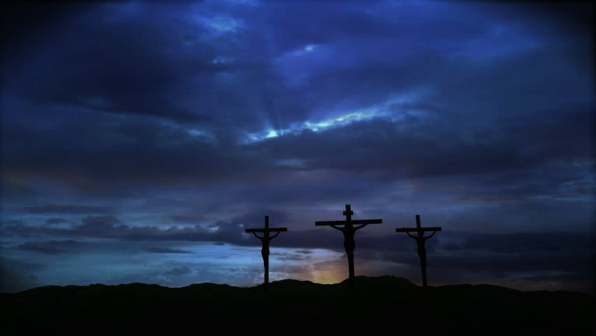
It is Finished!
(Matthew 27:45-54)

Slide 2
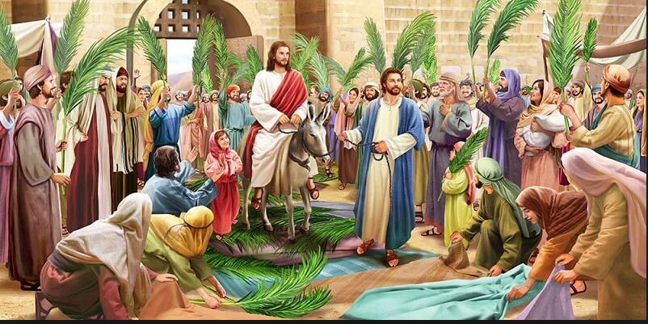

Slide 3
6 The disciples went and did as Jesus had directed them. 7 They brought the donkey and the colt and put on them their cloaks, and he sat on them. 8 Most of the crowd spread their cloaks on the road, and others cut branches from the trees and spread them on the road. 9 And the crowds that went before him and that followed him were shouting, “Hosanna to the Son of David! Blessed is he who comes in the name of the Lord! Hosanna in the highest!” 10 And when he entered Jerusalem, the whole city was stirred up, saying, “Who is this?” 11 And the crowds said, “This is the prophet Jesus, from Nazareth of Galilee.”
(Matthew 21:6-11)

Slide 4
It is Finished!
* Jesus finished the path of redemption.

Slide 5
13 Christ redeemed us from the curse of the law by becoming a curse for us—for it is written, “Cursed is everyone who is hanged on a tree”— 14 so that in Christ Jesus the blessing of Abraham might come to the Gentiles, so that we might receive the promised Spirit through faith.
(Galatians 3:13-14)

Slide 6
21 For our sake he made him to be sin who knew no sin, so that in him we might become the righteousness of God.
(2 Corinthians 5:21)

Slide 7
It is Finished!
* Jesus finished the path of redemption.
* Jesus furnished the price of reconciliation.

Slide 8
1 Behold, the Lord's hand is not shortened, that it cannot save, or his ear dull, that it cannot hear; 2 but your iniquities have made a separation between you and your God, and your sins have hidden his face from you so that he does not hear.
(Isaiah 59:1-2)

Slide 9
10 we have been sanctified through the offering of the body of Jesus Christ once for all. …
19 Therefore, brothers, since we have confidence to enter the holy places by the blood of Jesus, 20 by the new and living way that he opened for us through the curtain, that is, through his flesh, 21 and since we have a great priest over the house of God, 22 let us draw near with a true heart in full assurance of faith, with our hearts sprinkled clean from an evil conscience and our bodies washed with pure water. 23 Let us hold fast the confession of our hope without wavering, for he who promised is faithful. 24 And let us consider how to stir up one another to love and good works, 25 not neglecting to meet together, as is the habit of some, but encouraging one another, and all the more as you see the Day drawing near.
(Hebrews 10:10, 19-25)

Slide 10
It is Finished!
* Jesus finished the path of redemption.
* Jesus furnished the price of reconciliation.
* Jesus foreshadows the promise of resurrection.

Slide 11
20 But in fact Christ has been raised from the dead, the firstfruits of those who have fallen asleep. 21 For as by a man came death, by a man has come also the resurrection of the dead. 22 For as in Adam all die, so also in Christ shall all be made alive. 23 But each in his own order: Christ the firstfruits, then at his coming those who belong to Christ.
(1 Corinthians 5:20-23)

Slide 12
13 But we do not want you to be uninformed, brothers, about those who are asleep, that you may not grieve as others do who have no hope. 14 For since we believe that Jesus died and rose again, even so, through Jesus, God will bring with him those who have fallen asleep. 15 For this we declare to you by a word from the Lord, that we who are alive, who are left until the coming of the Lord, will not precede those who have fallen asleep. 16 For the Lord himself will descend from heaven with a cry of command, with the voice of an archangel, and with the sound of the trumpet of God. And the dead in Christ will rise first. 17 Then we who are alive, who are left, will be caught up together with them in the clouds to meet the Lord in the air, and so we will always be with the Lord. 18 Therefore encourage one another with these words.
(1 Thessalonians 4:13-18)

Slide 13
It is Finished!
* Jesus finished the path of redemption.
* Jesus furnished the price of reconciliation.
* Jesus foreshadows the promise of resurrection.
* Jesus forces the pronouncement of response.

Slide 14
Response
* Repent and put your faith in Jesus Christ.

Slide 15
16 “For God so loved the world, that he gave his only Son, that whoever believes in him should not perish but have eternal life. 17 For God did not send his Son into the world to condemn the world, but in order that the world might be saved through him. 18 Whoever believes in him is not condemned, but whoever does not believe is condemned already, because he has not believed in the name of the only Son of God. 19 And this is the judgment: the light has come into the world, and people loved the darkness rather than the light because their works were evil. 20 For everyone who does wicked things hates the light and does not come to the light, lest his works should be exposed. 21 But whoever does what is true comes to the light, so that it may be clearly seen that his works have been carried out in God.”
(John 3:16-21)

Slide 16
9 if you confess with your mouth that Jesus is Lord and believe in your heart that God raised him from the dead, you will be saved. 10 For with the heart one believes and is justified, and with the mouth one confesses and is saved. 11 For the Scripture says, “Everyone who believes in him will not be put to shame.”
(Romans 10:9-11)

Slide 17
Response
* Repent and put your faith in Jesus Christ.
* Choose whom you will serve.

Slide 18
You were bought with a price. So glorify God in your body.
(1 Corinthians 6:20)

Slide 19
1 And you were dead in the trespasses and sins 2 in which you once walked, following the course of this world, following the prince of the power of the air, the spirit that is now at work in the sons of disobedience— 3 among whom we all once lived in the passions of our flesh, carrying out the desires of the body and the mind, and were by nature children of wrath, like the rest of mankind.
(Ephesians 2:1-9)

Slide 20
4 But God, being rich in mercy, because of the great love with which he loved us, 5 even when we were dead in our trespasses, made us alive together with Christ—by grace you have been saved— 6 and raised us up with him and seated us with him in the heavenly places in Christ Jesus, 7 so that in the coming ages he might show the immeasurable riches of his grace in kindness toward us in Christ Jesus. 8 For by grace you have been saved through faith. And this is not your own doing; it is the gift of God, 9 not a result of works, so that no one may boast. 10 For we are his workmanship, created in Christ Jesus for good works, which God prepared beforehand, that we should walk in them.
(Ephesians 2:1-9)

Slide 21
14 “Now therefore fear the Lord and serve him in sincerity and in faithfulness. Put away the gods that your fathers served beyond the River and in Egypt, and serve the Lord. 15 And if it is evil in your eyes to serve the Lord, choose this day whom you will serve, whether the gods your fathers served in the region beyond the River, or the gods of the Amorites in whose land you dwell. But as for me and my house, we will serve the Lord.”
(Joshua 24:14-15)

