Slide 1
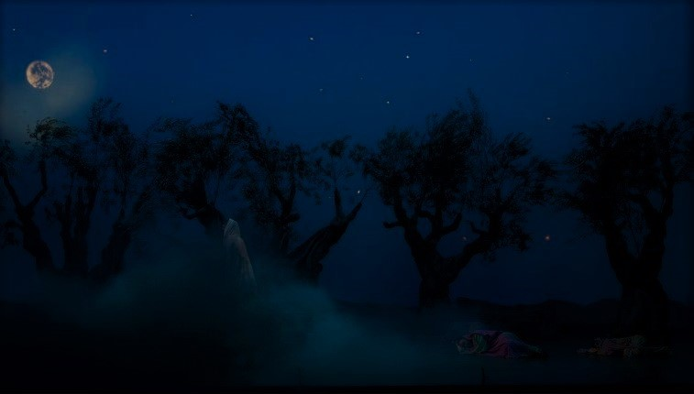
Christ When Pressed
(Matthew 26:30-56)

Slide 3
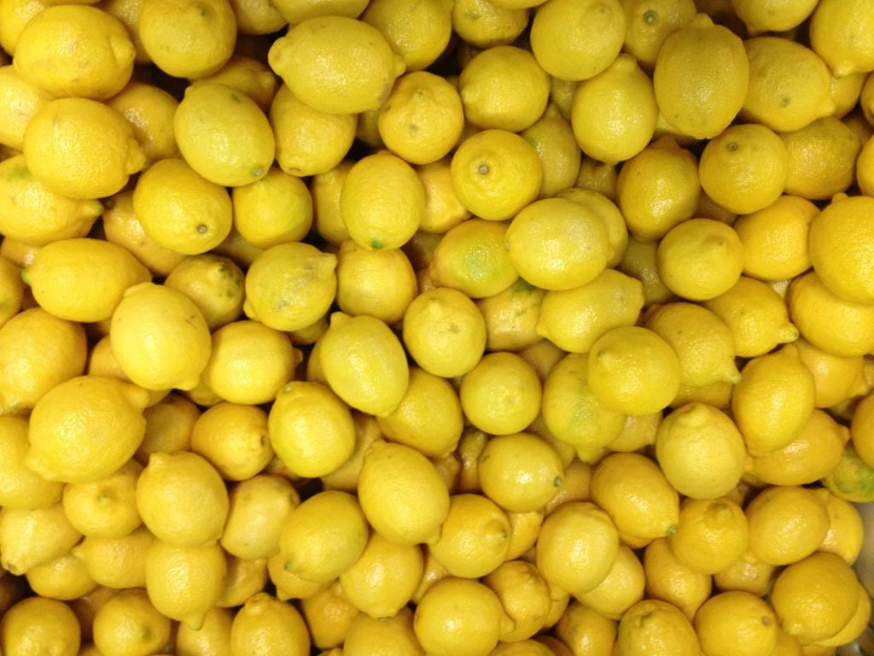

Slide 4
Christ When Pressed
* When pressed Jesus displays his humanity.

Slide 5
5 Christ Jesus, 6 who, though he was in the form of God, did not count equality with God a thing to be grasped, 7 but emptied himself, by taking the form of a servant, being born in the likeness of men. 8 And being found in human form, he humbled himself by becoming obedient to the point of death, even death on a cross.
(Philippians 2:5-8)

Slide 6
1 In the beginning was the Word, and the Word was with God, and the Word was God. 2 He was in the beginning with God. 3 All things were made through him, and without him was not any thing made that was made. ... 14 And the Word became flesh and dwelt among us, and we have seen his glory, glory as of the only Son from the Father, full of grace and truth.
(John 1:1-14)

Slide 7
44 And being in agony he prayed more earnestly; and his sweat became like great drops of blood falling down to the ground.
(Luke 22:44)

Slide 8
* When pressed remember that you have a High Priest who can empathize with you in your sorrows.
* When pressed bring your sorrows to your heavenly Father.

Slide 9
14 Since then we have a great high priest who has passed through the heavens, Jesus, the Son of God, let us hold fast our confession. 15 For we do not have a high priest who is unable to sympathize with our weaknesses, but one who in every respect has been tempted as we are, yet without sin. 16 Let us then with confidence draw near to the throne of grace, that we may receive mercy and find grace to help in time of need.
(Hebrews 4:14-16)

Slide 10
Christ When Pressed
* When pressed Jesus displays his humanity.
* When pressed Jesus displays his grace.

Slide 11
45 And when he rose from prayer, he came to the disciples and found them sleeping for sorrow,
(Luke 22:45)

Slide 12
* When pressed remember that God knows your weaknesses and is gracious toward you.

Slide 13
8 The Lord is merciful and gracious, slow to anger and abounding in steadfast love. 9 He will not always chide, nor will he keep his anger forever. 10 He does not deal with us according to our sins, nor repay us according to our iniquities. 11 For as high as the heavens are above the earth, so great is his steadfast love toward those who fear him; 12 as far as the east is from the west, so far does he remove our transgressions from us. 13 As a father shows compassion to his children, so the Lord shows compassion to those who fear him. 14 For he knows our frame; he remembers that we are dust.
(Psalm 103:6-14)

Slide 14
* When pressed remember that God knows your weaknesses and is gracious toward you.
* When pressed remember that God’s graciousness is rooted in what Christ has done for you.

Slide 15
1 There is therefore now no condemnation for those who are in Christ Jesus. 2 For the law of the Spirit of life has set you free in Christ Jesus from the law of sin and death. 3 For God has done what the law, weakened by the flesh, could not do. By sending his own Son in the likeness of sinful flesh and for sin, he condemned sin in the flesh, 4 in order that the righteous requirement of the law might be fulfilled in us, who walk not according to the flesh but according to the Spirit.
(Romans 8:1-4)

Slide 16
* When pressed remember that God knows your weaknesses and is gracious toward you.
* When pressed remember that God’s graciousness is rooted in what Christ has done for you.
* When pressed show grace to others.

Slide 17
1 I therefore, a prisoner for the Lord, urge you to walk in a manner worthy of the calling to which you have been called, 2 with all humility and gentleness, with patience, bearing with one another in love, 3 eager to maintain the unity of the Spirit in the bond of peace. 4 There is one body and one Spirit—just as you were called to the one hope that belongs to your call— 5 one Lord, one faith, one baptism, 6 one God and Father of all, who is over all and through all and in all.
(Ephesians 4:1-6)

Slide 18
15 We who are strong have an obligation to bear with the failings of the weak, and not to please ourselves.
(Romans 15:1)

Slide 19
Christ When Pressed
* When pressed Jesus displays his humanity.
* When pressed Jesus displays his grace.
* When pressed Jesus displays his humility.

Slide 20
49 And when those who were around him saw what would follow, they said, “Lord, shall we strike with the sword?” 50 And one of them struck the servant of the high priest and cut off his right ear. 51 But Jesus said, “No more of this!” And he touched his ear and healed him.
(Luke 22:49-51)

Slide 21
4 Then Jesus, knowing all that would happen to him, came forward and said to them, “Whom do you seek?” 5 They answered him, “Jesus of Nazareth.” Jesus said to them, “I am he.” Judas, who betrayed him, was standing with them. 6 When Jesus said to them, “I am he,” they drew back and fell to the ground. 7 So he asked them again, “Whom do you seek?” And they said, “Jesus of Nazareth.” 8 Jesus answered, “I told you that I am he. So, if you seek me, let these men go.” 9 This was to fulfill the word that he had spoken: “Of those whom you gave me I have lost not one.” 10 Then Simon Peter, having a sword, drew it and struck the high priest's servant and cut off his right ear. (The servant's name was Malchus.) 11 So Jesus said to Peter, “Put your sword into its sheath; shall I not drink the cup that the Father has given me?”
(John 18:4-10)

Slide 22
* When pressed exhibit humility.
* Humility is not self-deprecation, but the elevation of others.

Slide 23
2 So if there is any encouragement in Christ, any comfort from love, any participation in the Spirit, any affection and sympathy, 2 complete my joy by being of the same mind, having the same love, being in full accord and of one mind. 3 Do nothing from selfish ambition or conceit, but in humility count others more significant than yourselves. 4 Let each of you look not only to his own interests, but also to the interests of others. 5 Have this mind among yourselves, which is yours in Christ Jesus, 6 who, though he was in the form of God, did not count equality with God a thing to be grasped, 7 but emptied himself, by taking the form of a servant, being born in the likeness of men. 8 And being found in human form, he humbled himself by becoming obedient to the point of death, even death on a cross.
(Philippians 2:2-8)

Slide 24
Christ When Pressed
* When pressed Jesus displays his humanity.
* When pressed Jesus displays his grace.
* When pressed Jesus displays his humility.
* When pressed Jesus displays his submission.

Slide 25
* When pressed submit to God to experience His grace.

Slide 26
7 So to keep me from becoming conceited because of the surpassing greatness of the revelations, a thorn was given me in the flesh, a messenger of Satan to harass me, to keep me from becoming conceited. 8 Three times I pleaded with the Lord about this, that it should leave me. 9 But he said to me, “My grace is sufficient for you, for my power is made perfect in weakness.” Therefore I will boast all the more gladly of my weaknesses, so that the power of Christ may rest upon me. 10 For the sake of Christ, then, I am content with weaknesses, insults, hardships, persecutions, and calamities. For when I am weak, then I am strong.
(2 Corinthians 12:7-10)

Slide 27
* When pressed submit to God to experience His grace.
* When pressed submit to God to see His goodness.

Slide 28
19 But Joseph said to them, “Do not fear, for am I in the place of God? 20 As for you, you meant evil against me, but God meant it for good, to bring it about that many people should be kept alive, as they are today. 21 So do not fear; I will provide for you and your little ones.” Thus he comforted them and spoke kindly to them.
(Genesis 50:19-21)

Slide 29
* When pressed submit to God to experience His grace.
* When pressed submit to God to see God’s goodness.
* When pressed submit to God to become more like Christ.

Slide 30
28 And we know that for those who love God all things work together for good, for those who are called according to his purpose. 29 For those whom he foreknew he also predestined to be conformed to the image of his Son, in order that he might be the firstborn among many brothers.
(Romans 8:28-29)

Slide 31
* When pressed submit to God to experience His grace.
* When pressed submit to God to see God’s goodness.
* When pressed submit to God to become more like Christ.
* When pressed remember that it is okay to sorrow and grieve, but not to mope.

Slide 32
Christ When Pressed
* When pressed Jesus displays his humanity.
* When pressed Jesus displays his grace.
* When pressed Jesus displays his humility.
* When pressed Jesus displays his submission.
* When pressed Jesus displays his love.

Slide 33
* When pressed remember God’s love.

Slide 34
6 For while we were still weak, at the right time Christ died for the ungodly. 7 For one will scarcely die for a righteous person—though perhaps for a good person one would dare even to die— 8 but God shows his love for us in that while we were still sinners, Christ died for us.
(Romans 5:6-8)

Slide 35
* When pressed remember God’s love.
* When pressed love others.

Slide 36
12 “This is my commandment, that you love one another as I have loved you. 13 Greater love has no one than this, that someone lay down his life for his friends.
(John 15:13)

Slide 37
7 Beloved, let us love one another, for love is from God, and whoever loves has been born of God and knows God. 8 Anyone who does not love does not know God, because God is love. 9 In this the love of God was made manifest among us, that God sent his only Son into the world, so that we might live through him. 10 In this is love, not that we have loved God but that he loved us and sent his Son to be the propitiation for our sins. 11 Beloved, if God so loved us, we also ought to love one another. 12 No one has ever seen God; if we love one another, God abides in us and his love is perfected in us.
(1 John 4:7-12)

Slide 38
Christ When Pressed
* When pressed Jesus displays his humanity.
* When pressed Jesus displays his grace.
* When pressed Jesus displays his humility.
* When pressed Jesus displays his submission.
* When pressed Jesus displays his love.

Slide 39
Response
* We all go through presses (Gethsemanes) in life.
* When pressed do you want to go through it without or with God?
* When pressed what squeezes out of you?
* When pressed in who or what do you trust?

