Slide 1
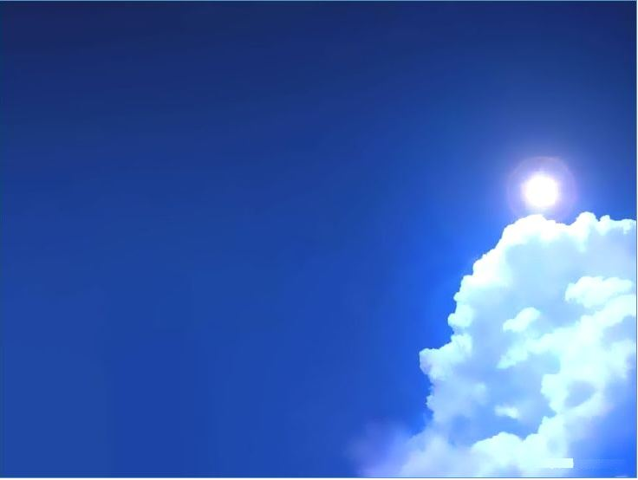
Kingdom Come:
Preparing for the Coming Kingdom
Matthew 24:32-51

Slide 3
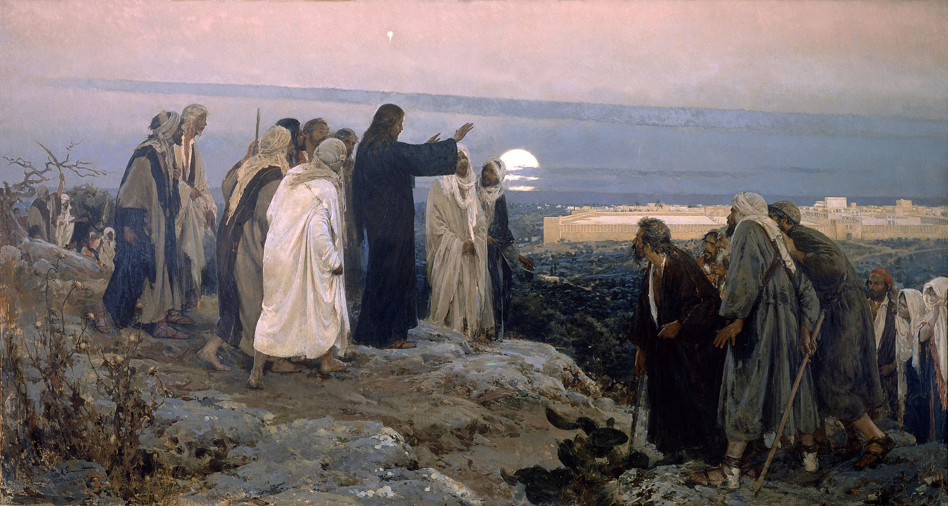

Slide 4
12 When he opened the sixth seal, I looked, and behold, there was a great earthquake, and the sun became black as sackcloth, the full moon became like blood, 13 and the stars of the sky fell to the earth as the fig tree sheds its winter fruit when shaken by a gale. 14 The sky vanished like a scroll that is being rolled up, and every mountain and island was removed from its place.
(Revelation 6:12-17)

Slide 5
15 Then the kings of the earth and the great ones and the generals and the rich and the powerful, and everyone, slave and free, hid themselves in the caves and among the rocks of the mountains, 16 calling to the mountains and rocks, “Fall on us and hide us from the face of him who is seated on the throne, and from the wrath of the Lamb, 17 for the great day of their wrath has come, and who can stand?”
(Revelation 6:12-17)

Slide 6
Preparing for the Coming Kingdom
* We prepare for the coming Kingdom by watching the seasons.

Slide 7
16 And the Pharisees and Sadducees came, and to test him they asked him to show them a sign from heaven. 2 He answered them, “When it is evening, you say, ‘It will be fair weather, for the sky is red.’ 3 And in the morning, ‘It will be stormy today, for the sky is red and threatening.’ You know how to interpret the appearance of the sky, but you cannot interpret the signs of the times. 4 An evil and adulterous generation seeks for a sign, but no sign will be given to it except the sign of Jonah.” So he left them and departed.
(Matthew 16:1-4)
* We need to interpret the times through Scripture; not Scripture through the times.

Slide 8
1 The word of the Lord came to me: 2 “Son of man, speak to your people and say to them, If I bring the sword upon a land, and the people of the land take a man from among them, and make him their watchman, 3 and if he sees the sword coming upon the land and blows the trumpet and warns the people, 4 then if anyone who hears the sound of the trumpet does not take warning, and the sword comes and takes him away, his blood shall be upon his own head.
(Ezekiel 33:1-6)

Slide 9
5 He heard the sound of the trumpet and did not take warning; his blood shall be upon himself. But if he had taken warning, he would have saved his life. 6 But if the watchman sees the sword coming and does not blow the trumpet, so that the people are not warned, and the sword comes and takes any one of them, that person is taken away in his iniquity, but his blood I will require at the watchman's hand.
(Ezekiel 33:1-6)
* We are called to be the watchmen on the wall.

Slide 10
Preparing for the Coming Kingdom
* We prepare for the coming Kingdom by watching the seasons.
* We prepare for the coming Kingdom by humbly resisting setting dates.

Slide 11
False Predictions
Predicted Date Claimant
500 Hippolytus of Rome, Sextus Julius Africanus, Irenaeus
793 Apr 6 Beatus of Liébana
1000 Jan 1 Pope Sylvester II
1260 Joachim of Fiore
1370 Jean de Roquetaillade
1504 Sandro Botticelli
1524 Feb 20 Johannes Stöffler
1524–1526 Thomas Müntzer
1533 Oct 19 Michael Stifel
1673 William Aspinwall
1694 Johann Jacob Zimmermann, John Mason and Johann Heinrich Alsted
1700 Henry Archer
1757 Emanuel Swedenborg
1793–1795 Richard Brothers
1814 Dec 25 Joanna Southcott

Slide 12
False Predictions
Predicted Date Claimant
1829 Sep 15 George Rapp
1836 John Wesley
1844 Oct 22 William Miller, Millerites
1847 Aug 7 George Rapp
1861 Joseph Morris
1863 John Wroe
1874 Charles Taze Russell
1890 Wovoka
1891 Joseph Smith, Mormons
1901 Catholic Apostolic Church
1914 Jehovah's Witnesses
1915 John Chilembwe
1917–1930 Sun Myung Moon
1930–1939 Rudolf Steiner
1935, 1943, 1972 & 1975 Herbert W. Armstrong

Slide 13
False Predictions
Predicted Date Claimant
1982 Jun 21 Benjamin Creme
1988 Edgar C. Whisenant
1994 Sep 6 Harold Camping
1999–2009 Jerry Falwell
2000 Ed Dobson, Timothy Dwight IV, Edgar Cayce,
Isaac Newton
2000, April 6 James Harmston
2011 May 21 Harold Camping
2011 Oct 21 Harold Camping
2011 Sep 29 Ronald Weinland
2012 May 27 Ronald Weinland
2013 May 18 Ronald Weinland
2012 Jack Van Impe
2015 Sep 28 Mark Biltz

Slide 14
1 This is now the second letter that I am writing to you, beloved. In both of them I am stirring up your sincere mind by way of reminder, 2 that you should remember the predictions of the holy prophets and the commandment of the Lord and Savior through your apostles, 3 knowing this first of all, that scoffers will come in the last days with scoffing, following their own sinful desires. 4 They will say, “Where is the promise of his coming? For ever since the fathers fell asleep, all things are continuing as they were from the beginning of creation.”
(2 Peter 3:1-7)

Slide 15
5 For they deliberately overlook this fact, that the heavens existed long ago, and the earth was formed out of water and through water by the word of God, 6 and that by means of these the world that then existed was deluged with water and perished. 7 But by the same word the heavens and earth that now exist are stored up for fire, being kept until the day of judgment and destruction of the ungodly.
(2 Peter 3:1-7)

Slide 16
Dangers of Setting Dates
- Do not set dates and feed the scoffers.
- Do not set dates so you do not lose hope.

Slide 17
Preparing for the Coming Kingdom
* We prepare for the coming Kingdom by watching the seasons.
* We prepare for the coming Kingdom by humbly resisting setting dates.
* We prepare for the coming Kingdom by expecting its coming.

Slide 18
1 When man began to multiply on the face of the land and daughters were born to them, 2 the sons of God saw that the daughters of man were attractive. And they took as their wives any they chose. 3 Then the Lord said, “My Spirit shall not abide in man forever, for he is flesh: his days shall be 120 years.” 4 The Nephilim were on the earth in those days, and also afterward, when the sons of God came in to the daughters of man and they bore children to them. These were the mighty men who were of old, the men of renown.
(Genesis 6:1-8)

Slide 19
5 The Lord saw that the wickedness of man was great in the earth, and that every intention of the thoughts of his heart was only evil continually. 6 And the Lord regretted that he had made man on the earth, and it grieved him to his heart. 7 So the Lord said, “I will blot out man whom I have created from the face of the land, man and animals and creeping things and birds of the heavens, for I am sorry that I have made them.” 8 But Noah found favor in the eyes of the Lord.
(Genesis 6:1-8)

Slide 20
11 Now the earth was corrupt in God's sight, and the earth was filled with violence. 12 And God saw the earth, and behold, it was corrupt, for all flesh had corrupted their way on the earth. 13 And God said to Noah, “I have determined to make an end of all flesh, for the earth is filled with violence through them. Behold, I will destroy them with the earth.
(Genesis 6:11-13)

Slide 21
26 Just as it was in the days of Noah, so will it be in the days of the Son of Man. 27 They were eating and drinking and marrying and being given in marriage, until the day when Noah entered the ark, and the flood came and destroyed them all. 28 Likewise, just as it was in the days of Lot—they were eating and drinking, buying and selling, planting and building, 29 but on the day when Lot went out from Sodom, fire and sulfur rained from heaven and destroyed them all— 30 so will it be on the day when the Son of Man is revealed.
(Luke 17:26-29)

Slide 22
5 if he did not spare the ancient world, but preserved Noah, a herald of righteousness, with seven others, when he brought a flood upon the world of the ungodly; 6 if by turning the cities of Sodom and Gomorrah to ashes he condemned them to extinction, making them an example of what is going to happen to the ungodly; 7 and if he rescued righteous Lot, greatly distressed by the sensual conduct of the wicked 8 (for as that righteous man lived among them day after day, he was tormenting his righteous soul over their lawless deeds that he saw and heard)
(2 Peter 2:5-7)

Slide 23
13 But we do not want you to be uninformed, brothers, about those who are asleep, that you may not grieve as others do who have no hope. 14 For since we believe that Jesus died and rose again, even so, through Jesus, God will bring with him those who have fallen asleep. 15 For this we declare to you by a word from the Lord, that we who are alive, who are left until the coming of the Lord, will not precede those who have fallen asleep.
(1 Thessalonians 4:13-18)

Slide 24
16 For the Lord himself will descend from heaven with a cry of command, with the voice of an archangel, and with the sound of the trumpet of God. And the dead in Christ will rise first. 17 Then we who are alive, who are left, will be caught up together with them in the clouds to meet the Lord in the air, and so we will always be with the Lord. 18 Therefore encourage one another with these words.
(1 Thessalonians 4:13-18)

Slide 25
10 Because you have kept my word about patient endurance, I will keep you from the hour of trial that is coming on the whole world, to try those who dwell on the earth. 11 I am coming soon. Hold fast what you have, so that no one may seize your crown.
(Revelation 3:10-11)

Slide 26
1 After this I looked, and behold, a door standing open in heaven! And the first voice, which I had heard speaking to me like a trumpet, said, “Come up here, and I will show you what must take place after this.”
(Revelation 4:1)

Slide 27
2 Now concerning the coming of our Lord Jesus Christ and our being gathered together to him, we ask you, brothers, 2 not to be quickly shaken in mind or alarmed, either by a spirit or a spoken word, or a letter seeming to be from us, to the effect that the day of the Lord has come. 3 Let no one deceive you in any way. For that day will not come, unless the rebellion comes first, and the man of lawlessness[b] is revealed, the son of destruction, 4 who opposes and exalts himself against every so-called god or object of worship, so that he takes his seat in the temple of God, proclaiming himself to be God.
(2 Thessalonians 2:2-8)

Slide 28
5 Do you not remember that when I was still with you I told you these things? 6 And you know what is restraining him now so that he may be revealed in his time. 7 For the mystery of lawlessness is already at work. Only he who now restrains it will do so until he is out of the way. 8 And then the lawless one will be revealed, whom the Lord Jesus will kill with the breath of his mouth and bring to nothing by the appearance of his coming.
(2 Thessalonians 2:2-8)

Slide 29
What should you do?
- Expect and look forward to the Lord’s return
1 For the grace of God has appeared, bringing salvation for all people, 12 training us to renounce ungodliness and worldly passions, and to live self-controlled, upright, and godly lives in the present age, 13 waiting for our blessed hope, the appearing of the glory of our great God and Savior Jesus Christ, 14 who gave himself for us to redeem us from all lawlessness and to purify for himself a people for his own possession who are zealous for good works.
(Titus 2:11-14)

Slide 30
What should you do?
- Expect and look forward to the Lord’s return
- Expect Jesus to return at any time, when we least expect it. (That is anytime)

Slide 31
Preparing for the Coming Kingdom
* We prepare for the coming Kingdom by watching the seasons.
* We prepare for the coming Kingdom by humbly resisting setting dates.
* We prepare for the coming Kingdom by expecting its coming.
* We prepare for the coming Kingdom by faithfully occupying until it comes.

Slide 32
The Faithful Servant
- The faithful servant serves as a steward of the Mater's house.
- The faithful servant serves trusts the Master to reward in His timing.
- The faithful servant serves the Master faithfuly until the end.
- The faithful servant receives authority and reward in Master's kingdom.

Slide 33
The Unfaithful Servant
- The unfaithful servant disregards the coming of the Master.
- The unfaithful servant treats the Master's people with contempt.
- The unfaithful servant lives for self and temporal pleasures.
- The unfaithful servant receives the punishment of a hypocrite.

Slide 34
21 “Not everyone who says to me, ‘Lord, Lord,’ will enter the kingdom of heaven, but the one who does the will of my Father who is in heaven. 22 On that day many will say to me, ‘Lord, Lord, did we not prophesy in your name, and cast out demons in your name, and do many mighty works in your name?’ 23 And then will I declare to them, ‘I never knew you; depart from me, you workers of lawlessness.’
(Matthew 7:21-23)

Slide 35
19 They went out from us, but they were not of us; for if they had been of us, they would have continued with us. But they went out, that it might become plain that they all are not of us.
(1 John 2:19)

Slide 36
The Unfaithful Servant
- The unfaithful servant disregards the coming of the Master.
- The unfaithful servant treats the Master's people with contempt.
- The unfaithful servant lives for self and temporal pleasures.
- The unfaithful servant receives the punishment of a hypocrite.
- The unfaithful servant is no servant of the Master at all.

Slide 37
Which servant are you?

Slide 38
Preparing for the Coming Kingdom
* We prepare for the coming Kingdom by watching the seasons.
* We prepare for the coming Kingdom by humbly resisting setting dates.
* We prepare for the coming Kingdom by expecting its coming.
* We prepare for the coming Kingdom by faithfully occupying until it comes.

Slide 39
We prepare for the coming Kingdom by planning as if Jesus is coming back in a thousand years, …
... but living as though He is returning one second from now.

