Slide 1
Kingdom Come:
Game of Thrones
(Part I)
Matthew 24:15;
Daniel 2:31-45; 7:1-18

Slide 2
The Seven C’s of Consistent Interpretation
1. Context: The historical, literary, and grammatical context.
2. Common Sense: Take God’s Word at His word. Take the plainest meaning of the text unless the context deems otherwise.
3. Continuity: Treat the Bible as a whole;
Interpret Scripture with Scripture.
4. Complete fulfillment: God fulfills His Word completely, not partially.
5. Correlative fulfillment: If a prophecy is partially fulfilled look for progressive fulfillment or typological fulfillment.
6. Care: Hold your interpretations with humility.
7. Confidence: Trust God to fulfill His Word in His way.

Slide 3
Kingdom Come: The Coming Kingdom
God desires for people to be drawn into His Kingdom.
People willfully reject God's Kingdom
There are consequences for rejecting God's Kingdom
God's Kingdom is coming anyway

Slide 4
Kingdom Come: The Birth Pains of the Kingdom
1. False Christs
2. Conflicts (National, Regional, Ethnic)
3. Famines
4. Pestilences
5. Earthquakes (Natural Disasters)
6. Persecution of True Christians
7. False Prophets (Teachers and Teachings)
8. Lawlessness
9. Waning Love (Selfishness)
10. Gospel Spread

Slide 5
15 “So when you see the abomination of desolation spoken of by the prophet Daniel, standing in the holy place (let the reader understand)
(Matthew 24:15)

Slide 6
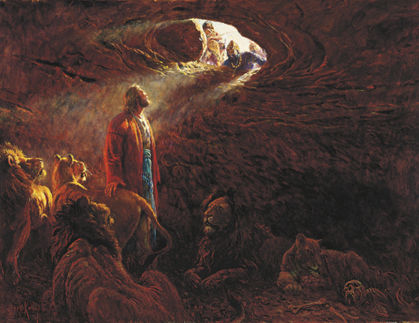
Background of Daniel
* Written by Daniel.
- Book claims so.
- Jesus claims so.
* Written between 605 B.C. to 536 B.C.
* Daniel was exiled from Judah to Babylon during the time of King Jehoiakim
(609-597 B.C.).
- Jeremiah 25 (Prophecy of Judah’s captivity in Babylon)
- 2 Kings 24-25 (Fulfillment of that prophecy)

Slide 7
Background of Daniel
* Daniel was trained to be a wiseman in the Babylonian court, yet maintained his faithfulness to God.
* Daniel ascended to a place of authority because of the wisdom and insight God granted him.
* Daniel served in a place of authority in both the Babylonian and Medo-Persian courts.

Slide 8
Language Outline of Daniel
Hebrew
1 Daniel’s Exile and Faithfulness.
2 Nebuchadnezzar’s Dream. (The Four Kingdoms of the Earth)
3 Nebuchadnezzar’s Golden Image and the Fiery Furnace.
4 Nebuchadnezzar’s Pride, Humiliation, and Restoration.
5 Handwriting on the Wall; The fall of Babylon and Rise of Medo-Persia.
6 Daniel and the Lion’s Den
7 Daniel’s vision of four beasts. (The Four Kingdoms of the Earth)
8 Daniel’s vision of the Ram and the Goat
9 Daniel’s prayer for his people and the Seventy Weeks.
10 Daniel’s Terrifying Vision of a Man.
11 The King’s of the South and the North.
12 The Time of the End.
Aramaic
Hebrew

Slide 9
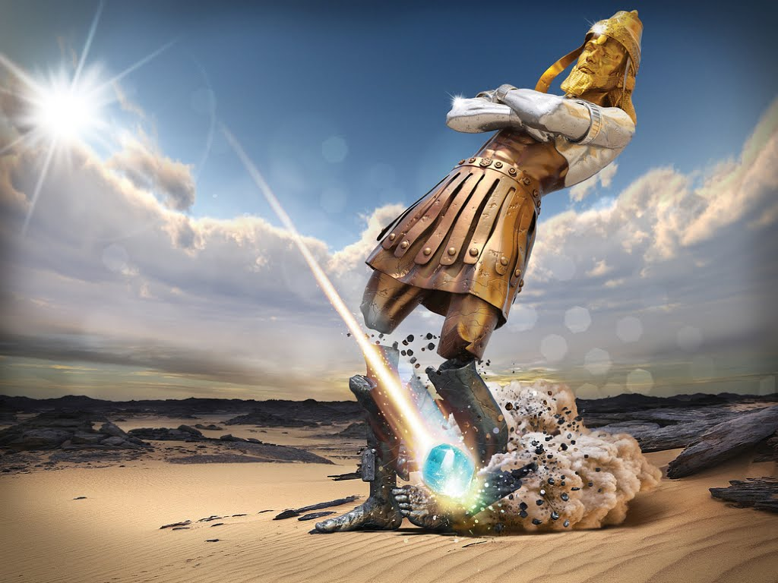

Slide 10
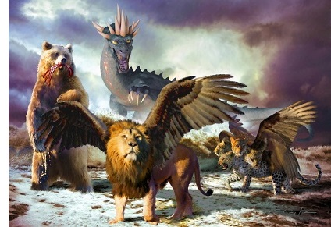

Slide 11
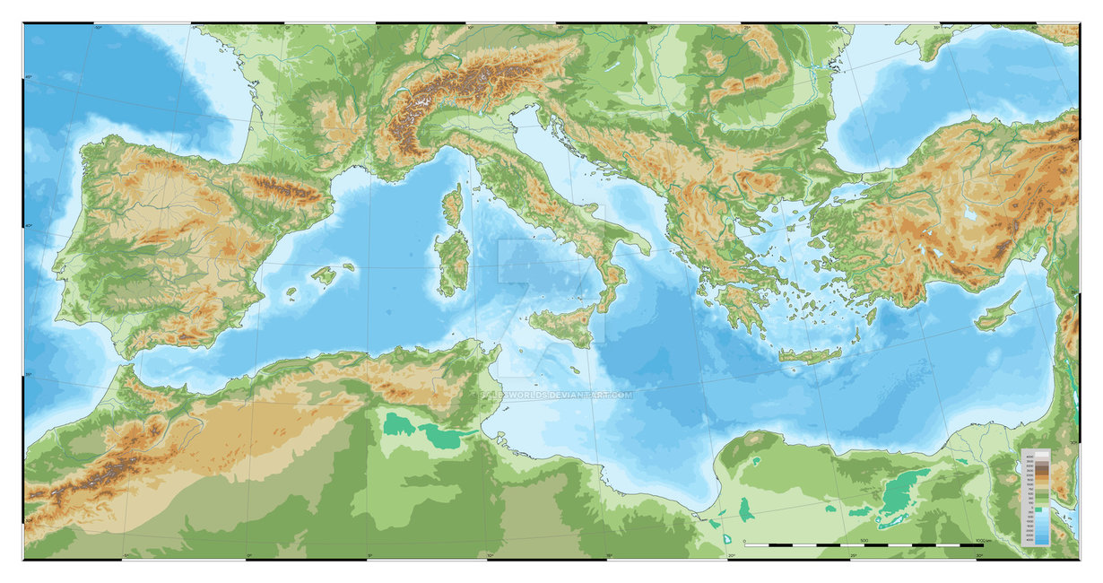

Slide 12
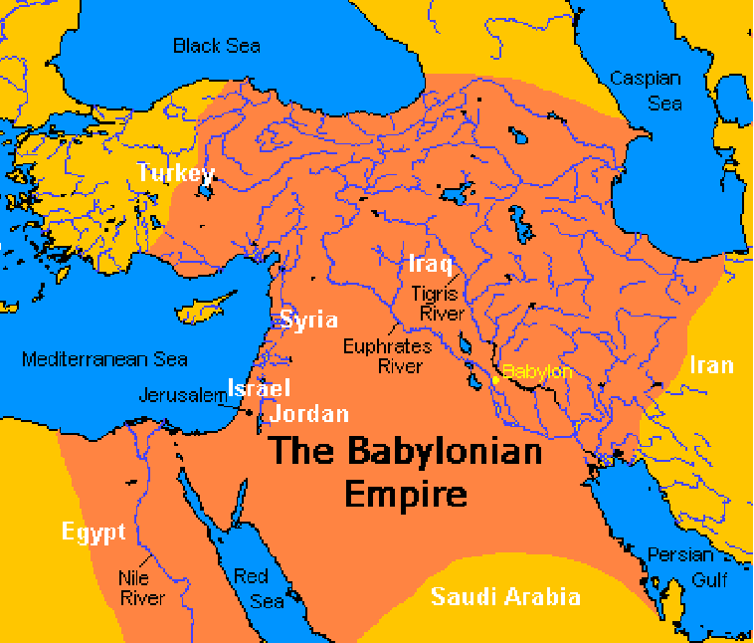
Babylonian Empire
(625-539 B.C.)

Slide 13
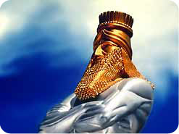
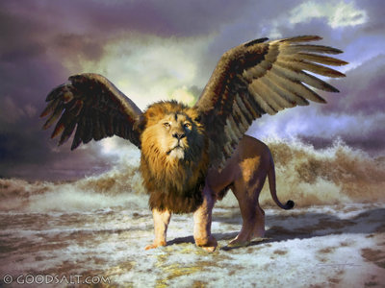
Babylonian Empire
(625-539 B.C.)
36 “This was the dream. Now we will tell the king its interpretation. 37 You, O king, the king of kings, to whom the God of heaven has given the kingdom, the power, and the might, and the glory, 38 and into whose hand he has given, wherever they dwell, the children of man, the beasts of the field, and the birds of the heavens, making you rule over them all—you are the head of gold.
(Daniel 2:36)

Slide 14
Babylonian Empire
(625-539 B.C.)
4 The first was like a lion and had eagles' wings. Then as I looked its wings were plucked off, and it was lifted up from the ground and made to stand on two feet like a man, and the mind of a man was given to it.
(Daniel 7:4)

Slide 15
Babylonian Empire
(625-539 B.C.)
* The Lion of Babylon is an ancient Babylonian symbol. The Lion of Babylon symbolically represented the King of Babylon. Often these lions had wings.

Slide 16
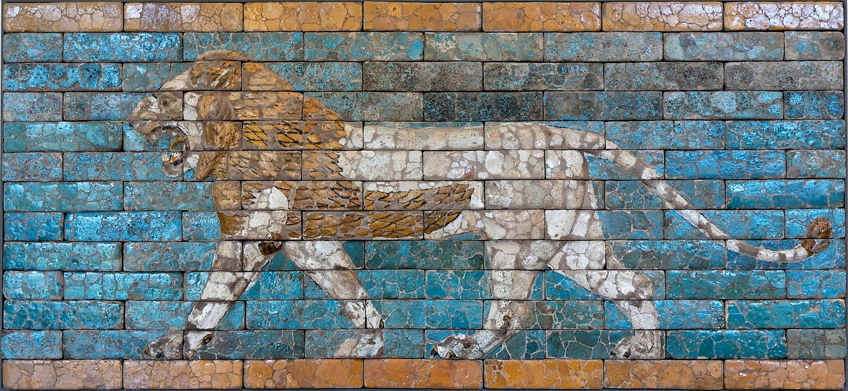

Slide 17
Babylonian Empire
(625-539 B.C.)
* The Lion of Babylon is an ancient Babylonian symbol. The Lion of Babylon symbolically represented the King of Babylon. Often these lions had wings.
* King Nebuchadnezzar’s pride, humiliation, and restoration. (Daniel 4)
* Replaced by an inferior kingdom. (Inferior in wealth, wisdom, and morality, but greater in strength).

Slide 18
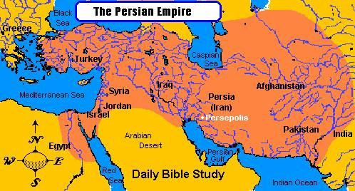
Medo-Persian Empire
(539-331 B.C.)

Slide 19
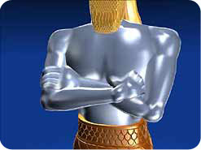
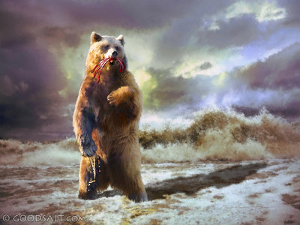
Medo-Persian Empire
(539-331 B.C.)
39 Another kingdom inferior to you shall arise after you,
(Daniel 2:39)
5 And behold, another beast, a second one, like a bear. It was raised up on one side. It had three ribs in its mouth between its teeth; and it was told, ‘Arise, devour much flesh.’
(Daniel 7:5)

Slide 20
Medo-Persian Empire
(539-331 B.C.)
* The Babylonian Empire was immediately replaced by the Medo-Persian Empire.
- This was also prophesied in Jeremiah 50-51
- Isaiah 45 prophesied a Medo-Persian ruler by by name: Cyrus.
(Isaiah 740-681B.C.; Cyrus 600-530 B.C)
- Babylonian fall and Medo-Persian rise chronicled in Daniel 5.

Slide 21
Medo-Persian Empire
(539-331 B.C.)
* Pictures a kind of lopsided bear with one side dominating its other. Although the empire was joint between the Medes and the Persians, the Persians dominated.
* The three ribs in the mouth probably refer to the three major empires the Medo-Persian empire conquered (Babylon, Egypt, and Lydia).

Slide 22
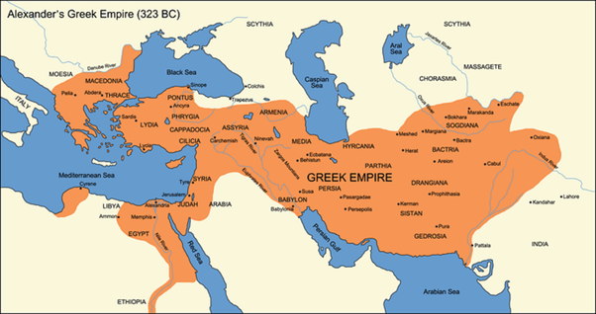
Greek Empire
(331-63 B.C.)

Slide 23
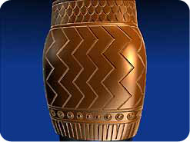
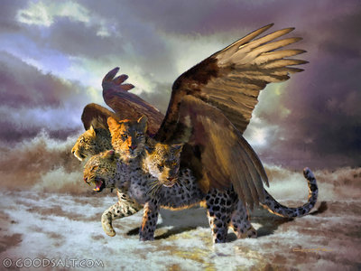
Greek Empire
(331-63 B.C.)
39 and yet a third kingdom of bronze, which shall rule over all the earth.
(Daniel 2:39)
6 After this I looked, and behold, another, like a leopard, with four wings of a bird on its back. And the beast had four heads, and dominion was given to it.
(Daniel 7:6)

Slide 24
Greek Empire
(331-63 B.C.)
* Replaced Medo-Persian Empire.
* Leopard with wings represent the swiftness of the spread of the empire. Alexander the Great conquered most of the known world in only about ten years (334-323 B.C.)
* Heads represent rulers (heads of state today). Alexander had no heir, so when he died the empire was split between four of his generals: Egypt under the Ptolemies; Syria under the Seleucids, Macedonia under the Antigonids, Pergamum under the Attalids.

Slide 25
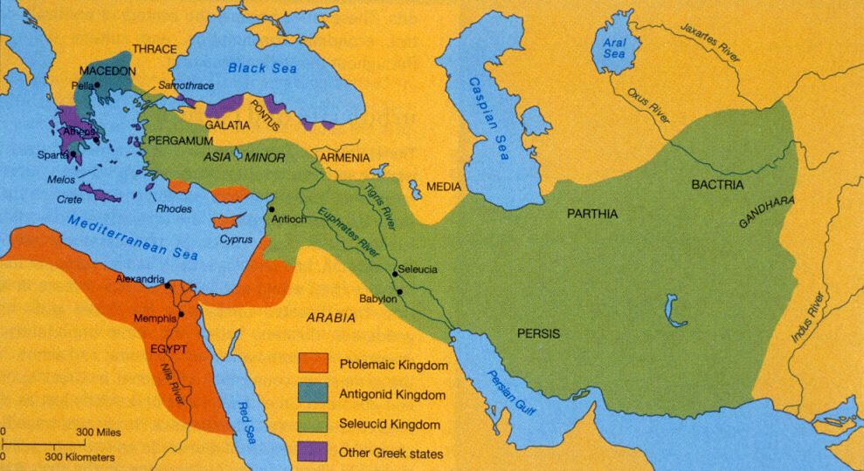
Greek Empire
(331-63 B.C.)

Slide 26
Greek Empire
(331-63 B.C.)
* Daniel 8 and parts of 11 prophesy about the events of this time.

Slide 27
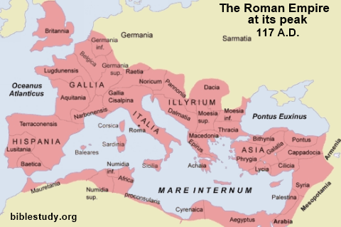
Roman Empire I
(63 BC – A.D. 476)

Slide 28
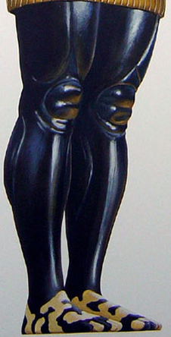
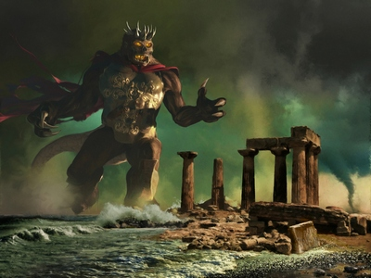
Roman Empire I
(63 BC – A.D. 476)
40 And there shall be a fourth kingdom, strong as iron, because iron breaks to pieces and shatters all things. And like iron that crushes, it shall break and crush all these.
(Daniel 2:40)
7 After this I saw in the night visions, and behold, a fourth beast, terrifying and dreadful and exceedingly strong. It had great iron teeth; it devoured and broke in pieces and stamped what was left with its feet.
(Daniel 7:7)

Slide 29
Roman Empire I
(63 BC – A.D. 476)
* Rome known for its military might and destruction. Where as the first three kingdoms attempted assimilation, Rome would just conquer and destroy. Might makes right.
* Just as the statue had two legs, Rome divided into two empires in A.D. 284: The Roman west and the Byzantine east.
* The Roman empire gradually disintegrated and Rome fell in A.D. 476.

Slide 30
All Things Are Not Yet Fulfilled
* It was not suddenly destroyed as depicted in the visions.
* No counterpart to the ten toes and the ten horns and the little horn that raised up in their midst. Horns being a symbol of authority or kingship.
* It was not replaced with God's Kingdom in Christ filling the whole earth.

Slide 31
19 “Then I desired to know the truth about the fourth beast, which was different from all the rest, exceedingly terrifying, with its teeth of iron and claws of bronze, and which devoured and broke in pieces and stamped what was left with its feet, 20 and about the ten horns that were on its head, and the other horn that came up and before which three of them fell, the horn that had eyes and a mouth that spoke great things, and that seemed greater than its companions. 21 As I looked, this horn made war with the saints and prevailed over them, 22 until the Ancient of Days came, and judgment was given for the saints of the Most High, and the time came when the saints possessed the kingdom.
(Daniel 7:19-22)

Slide 32
The Seven C’s of Consistent Interpretation
* Complete fulfillment: God fulfills His Word completely, not partially.
* Correlative fulfillment: If a prophecy is partially fulfilled look for progressive fulfillment or typological fulfillment.
* Example Ezekiel 28. Prophecy against the literal king of Tyre that then transition into a prophecy against Satan.

Slide 33
Roman Empire II
(Future)
* The Roman empire of history is a partial fulfillment and typological fulfillment of the Fourth Beast.
* There is a prophesied final world empire to come under the rule of the Antichrist.
* At the return of Jesus Christ this final empire will be destroyed and the Kingdom of God in Christ will fill the whole earth.

Slide 36
Your Response
1. Put your confidence in God’s word.

Slide 37
21 And if you say in your heart, ‘How may we know the word that the Lord has not spoken?’— 22 when a prophet speaks in the name of the Lord, if the word does not come to pass or come true, that is a word that the Lord has not spoken; the prophet has spoken it presumptuously. You need not be afraid of him.
(Deuteronomy 18:21-22)

Slide 38
8 “Remember this and stand firm, recall it to mind, you transgressors, 9 remember the former things of old; for I am God, and there is no other; I am God, and there is none like me, 10 declaring the end from the beginning and from ancient times things not yet done, saying, ‘My counsel shall stand, and I will accomplish all my purpose,’
(Isaiah 46:8-10)

Slide 39
Your Response
1. Put your confidence in God’s word.
2. Recognize that all nations and the world are temporary.

Slide 40
5 Heaven and earth will pass away, but my words will not pass away. (Matthew 24:35)

Slide 41
8 But do not overlook this one fact, beloved, that with the Lord one day is as a thousand years, and a thousand years as one day. 9 The Lord is not slow to fulfill his promise as some count slowness, but is patient toward you, not wishing that any should perish, but that all should reach repentance. 10 But the day of the Lord will come like a thief, and then the heavens will pass away with a roar, and the heavenly bodies will be burned up and dissolved, and the earth and the works that are done on it will be exposed.
(2 Peter 3:8-10)

Slide 42
15 Do not love the world or the things in the world. If anyone loves the world, the love of the Father is not in him. 16 For all that is in the world—the desires of the flesh and the desires of the eyes and pride of life—is not from the Father but is from the world. 17 And the world is passing away along with its desires, but whoever does the will of God abides forever.
(1 John 2:15-17)

Slide 43
19 “Do not lay up for yourselves treasures on earth, where moth and rust destroy and where thieves break in and steal, 20 but lay up for yourselves treasures in heaven, where neither moth nor rust destroys and where thieves do not break in and steal. 21 For where your treasure is, there your heart will be also.
(Matthew 6:19-21)

Slide 44
Your Response
1. Put your confidence in God’s word.
2. Recognize that all nations and the world are temporary.
3. Trust that the God who is sovereign over the nations is also sovereign over your life.

Slide 45
19 Then the mystery was revealed to Daniel in a vision of the night. Then Daniel blessed the God of heaven. 20 Daniel answered and said: “Blessed be the name of God forever and ever, to whom belong wisdom and might. 21 He changes times and seasons; he removes kings and sets up kings; he gives wisdom to the wise and knowledge to those who have understanding;
(Daniel 2:19-23)

Slide 46
22 he reveals deep and hidden things; he knows what is in the darkness, and the light dwells with him. 23 To you, O God of my fathers, I give thanks and praise, for you have given me wisdom and might, and have now made known to me what we asked of you, for you have made known to us the king's matter.”
(Daniel 2:19-23)

Slide 47
24 The God who made the world and everything in it, being Lord of heaven and earth, does not live in temples made by man, 25 nor is he served by human hands, as though he needed anything, since he himself gives to all mankind life and breath and everything.
(Acts 17:24-27)

Slide 48
26 And he made from one man every nation of mankind to live on all the face of the earth, having determined allotted periods and the boundaries of their dwelling place, 27 that they should seek God, and perhaps feel their way toward him and find him.
(Acts 17:24-27)

Slide 49
The heart of man plans his way, but the Lord establishes his steps.
(Proverbs 16:9)

Slide 50
Your Response
1. Put your confidence in God’s word.
2. Recognize that all nations and the world are temporary.
3. Trust that the God who is sovereign over the nations is also sovereign over your life.
4. Live as a sojourner, looking for your true home.

Slide 51
20 But our citizenship is in heaven, and from it we await a Savior, the Lord Jesus Christ, 21 who will transform our lowly body to be like his glorious body, by the power that enables him even to subject all things to himself.
(Ephesians 3:20-21)

Slide 52
13 These all died in faith, not having received the things promised, but having seen them and greeted them from afar, and having acknowledged that they were strangers and exiles on the earth. 14 For people who speak thus make it clear that they are seeking a homeland.
(Hebrews 11:13-16)

Slide 53
15 If they had been thinking of that land from which they had gone out, they would have had opportunity to return. 16 But as it is, they desire a better country, that is, a heavenly one. Therefore God is not ashamed to be called their God, for he has prepared for them a city.
(Hebrews 11:13-16)

Slide 54
Your Response
1. Put your confidence in God’s word.
2. Recognize that all nations and the world are temporary.
3. Trust that the God who is sovereign over the nations is also sovereign over your life.
4. Live as a sojourner, looking for your true home.

