Slide 1
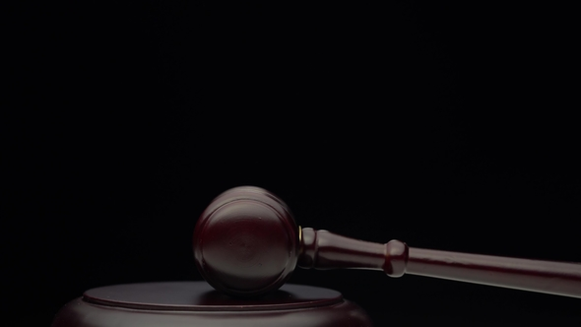
Jesus on Trial
(Matthew 26:47-68)

Slide 2
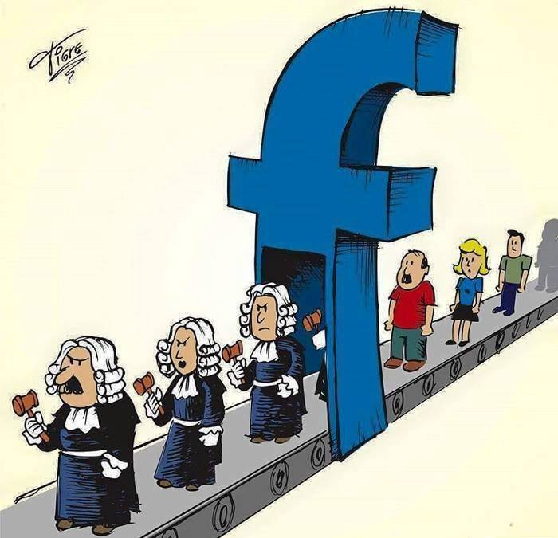

Slide 3
Jesus on Trial
* Jesus on trial by those who pay him "lip service".

Slide 4
4 But Judas Iscariot, one of his disciples (he who was about to betray him), said, 5 “Why was this ointment not sold for three hundred denarii and given to the poor?” 6 He said this, not because he cared about the poor, but because he was a thief, and having charge of the moneybag he used to help himself to what was put into it.
(John 12:4-6)

Slide 5
14 Then one of the twelve, whose name was Judas Iscariot, went to the chief priests 15 and said, “What will you give me if I deliver him over to you?” And they paid him thirty pieces of silver. 16 And from that moment he sought an opportunity to betray him.
(Matthew 26:14-15)

Slide 6
* Are your affections for the things of this world or for Christ?

Slide 7
15 Do not love the world or the things in the world. If anyone loves the world, the love of the Father is not in him. 16 For all that is in the world—the desires of the flesh and the desires of the eyes and pride of life—is not from the Father but is from the world. 17 And the world is passing away along with its desires, but whoever does the will of God abides forever.
(1 John 2:15-17)

Slide 8
* Are your affections for the things of this world or for Christ?
* Are your affections for your works for Christ or for the person of Christ?

Slide 9
21 “Not everyone who says to me, ‘Lord, Lord,’ will enter the kingdom of heaven, but the one who does the will of my Father who is in heaven. 22 On that day many will say to me, ‘Lord, Lord, did we not prophesy in your name, and cast out demons in your name, and do many mighty works in your name?’ 23 And then will I declare to them, ‘I never knew you; depart from me, you workers of lawlessness.’
(Matthew 7:21-23)

Slide 10
* Are your affections for the things of this world or for Christ?
* Are your affections for your works for Christ or for the person of Christ?
* Does the display of your affections bring honor to Christ?

Slide 11
14 “You are the light of the world. A city set on a hill cannot be hidden. 15 Nor do people light a lamp and put it under a basket, but on a stand, and it gives light to all in the house. 16 In the same way, let your light shine before others, so that they may see your good works and give glory to your Father who is in heaven. (Matthew 5:14-16)

Slide 12
15 For we are the aroma of Christ to God among those who are being saved and among those who are perishing, 16 to one a fragrance from death to death, to the other a fragrance from life to life.
(2 Corinthians 2:15-16)

Slide 13
Jesus on Trial
* Jesus on trial by those who pay him "lip service".
* Jesus on trial by the deceived cultural elite.

Slide 14
* Remember that evidence is not enough to convince anyone if they are predisposed to not believe.

Slide 15
31 He said to him, ‘If they do not hear Moses and the Prophets, neither will they be convinced if someone should rise from the dead.’
(Luke 16:31)

Slide 16
12 Indeed, all who desire to live a godly life in Christ Jesus will be persecuted, 13 while evil people and impostors will go on from bad to worse, deceiving and being deceived.
(2 Timothy 3:12-13)

Slide 17
2 They will put you out of the synagogues. Indeed, the hour is coming when whoever kills you will think he is offering service to God. 3 And they will do these things because they have not known the Father, nor me.
(John 16:2-3)

Slide 18
44 No one can come to me unless the Father who sent me draws him.
(John 6:44)

Slide 19
12 Now we have received not the spirit of the world, but the Spirit who is from God, that we might understand the things freely given us by God. 13 And we impart this in words not taught by human wisdom but taught by the Spirit, interpreting spiritual truths to those who are spiritual. 14 The natural person does not accept the things of the Spirit of God, for they are folly to him, and he is not able to understand them because they are spiritually discerned.
(2 Corinthians 2:12-14)

Slide 20
* Remember that evidence is not enough to convince anyone if they are predisposed to not believe.
* Put your faith in God rather than supposed experts.

Slide 21
1 Now faith is the assurance of things hoped for, the conviction of things not seen. 2 For by it the people of old received their commendation. 3 By faith we understand that the universe was created by the word of God, so that what is seen was not made out of things that are visible.
(Hebrews 11:1-3)

Slide 22
Jesus on Trial
* Jesus on trial by those who pay him "lip service".
* Jesus on trial by the deceived cultural elite.
* Jesus on trial by misunderstanding God's Word.

Slide 23
15 The Lord God took the man and put him in the garden of Eden to work it and keep it. 16 And the Lord God commanded the man, saying, “You may surely eat of every tree of the garden, 17 but of the tree of the knowledge of good and evil you shall not eat, for in the day that you eat of it you shall surely die.”
(Genesis 2:15-17)

Slide 24
1 Now the serpent was more crafty than any other beast of the field that the Lord God had made. He said to the woman, “Did God actually say, ‘You shall not eat of any tree in the garden’?” 2 And the woman said to the serpent, “We may eat of the fruit of the trees in the garden, 3 but God said, ‘You shall not eat of the fruit of the tree that is in the midst of the garden, neither shall you touch it, lest you die.’”
(Genesis 3:1-7)

Slide 25
4 But the serpent said to the woman, “You will not surely die. 5 For God knows that when you eat of it your eyes will be opened, and you will be like God, knowing good and evil.” 6 So when the woman saw that the tree was good for food, and that it was a delight to the eyes, and that the tree was to be desired to make one wise, she took of its fruit and ate, and she also gave some to her husband who was with her, and he ate. 7 Then the eyes of both were opened, and they knew that they were naked. And they sewed fig leaves together and made themselves loincloths.
(Genesis 3:1-7)

Slide 26
* Rightly divide the Word of God.

Slide 27
14 Remind them of these things, and charge them before God not to quarrel about words, which does no good, but only ruins the hearers. 15 Do your best to present yourself to God as one approved, a worker who has no need to be ashamed, rightly handling the word of truth.
(2 Timothy 2:14-15)

Slide 28
* Rightly divide the Word of God.
* Rightly live the Word of God.

Slide 29
22 But be doers of the word, and not hearers only, deceiving yourselves. 23 For if anyone is a hearer of the word and not a doer, he is like a man who looks intently at his natural face in a mirror. 24 For he looks at himself and goes away and at once forgets what he was like. 25 But the one who looks into the perfect law, the law of liberty, and perseveres, being no hearer who forgets but a doer who acts, he will be blessed in his doing.
(James 2:22-25)

Slide 30
Jesus on Trial
* Jesus on trial by those who pay him "lip service".
* Jesus on trial by the deceived cultural elite.
* Jesus on trial by misunderstanding God's Word.
* Jesus on trial by declaring himself to be God.

Slide 31
* Who do you say that Jesus is?

Slide 32
13 Now when Jesus came into the district of Caesarea Philippi, he asked his disciples, “Who do people say that the Son of Man is?” 14 And they said, “Some say John the Baptist, others say Elijah, and others Jeremiah or one of the prophets.” 15 He said to them, “But who do you say that I am?” 16 Simon Peter replied, “You are the Christ, the Son of the living God.” 17 And Jesus answered him, “Blessed are you, Simon Bar-Jonah! For flesh and blood has not revealed this to you, but my Father who is in heaven. 18 And I tell you, you are Peter, and on this rock I will build my church, and the gates of hell shall not prevail against it.
(Matthew 16:13-18)

Slide 33
* Who do you say that Jesus is?
* To be truly saved you must recognize Jesus is who he says he is: Lord.

Slide 34
9 if you confess with your mouth that Jesus is Lord and believe in your heart that God raised him from the dead, you will be saved. 10 For with the heart one believes and is justified, and with the mouth one confesses and is saved. 11 For the Scripture says, “Everyone who believes in him will not be put to shame.” 12 For there is no distinction between Jew and Greek; for the same Lord is Lord of all, bestowing his riches on all who call on him. 13 For “everyone who calls on the name of the Lord will be saved.”
(Romans 10:9-12)

Slide 35
Jesus on Trial
* Jesus on trial by those who pay him "lip service".
* Jesus on trial by the deceived cultural elite.
* Jesus on trial by misunderstanding God's Word.
* Jesus on trial by declaring himself to be God.
* Jesus on trial is actually us on trial.

Slide 36
* Know that we are already under judgment outside of Christ.

Slide 37
16 “For God so loved the world, that he gave his only Son, that whoever believes in him should not perish but have eternal life. 17 For God did not send his Son into the world to condemn the world, but in order that the world might be saved through him. 18 Whoever believes in him is not condemned, but whoever does not believe is condemned already, because he has not believed in the name of the only Son of God.
(John 1:16-21)

Slide 38
19 And this is the judgment: the light has come into the world, and people loved the darkness rather than the light because their works were evil. 20 For everyone who does wicked things hates the light and does not come to the light, lest his works should be exposed. 21 But whoever does what is true comes to the light, so that it may be clearly seen that his works have been carried out in God.”
(John 1:16-21)

Slide 39
* Know that we are already under judgment outside of Christ.
* Know that our judgment is paid for in Christ.

Slide 40
21 But now the righteousness of God has been manifested apart from the law, although the Law and the Prophets bear witness to it— 22 the righteousness of God through faith in Jesus Christ for all who believe. For there is no distinction: 23 for all have sinned and fall short of the glory of God, 24 and are justified by his grace as a gift, through the redemption that is in Christ Jesus, 25 whom God put forward as a propitiation by his blood, to be received by faith. This was to show God's righteousness, because in his divine forbearance he had passed over former sins. 26 It was to show his righteousness at the present time, so that he might be just and the justifier of the one who has faith in Jesus.
(Romans 3:21-26)

Slide 41
Jesus on Trial
* Jesus on trial by those who pay him "lip service".
* Jesus on trial by the deceived cultural elite.
* Jesus on trial by misunderstanding God's Word.
* Jesus on trial by declaring himself to be God.
* Jesus on trial is actually us on trial.

Slide 42
Response
* Are you in Christ or are you under the judgment of God?
* Is your faith just “lip service”?
* Where do you place your faith?
* Do you rightly divide the Word of Truth or do you treat the Bible as just another truth?
* Jesus asks you: “Who do you really say that I am?”

