Slide 1
Kingdom Come:
The Birth Pains of the Kingdom
(Part I)
Matthew 24:3-8)

Slide 2
Kingdom Come: The Coming Kingdom
God desires for people to be drawn into His Kingdom.
People willfully reject God's Kingdom
There are consequences for rejecting God's Kingdom
God's Kingdom is coming anyway

Slide 3
“Tell us, when will these things be, and what will be the sign of your coming and of the end of the age?”
(Matthew 24:3).

Slide 4
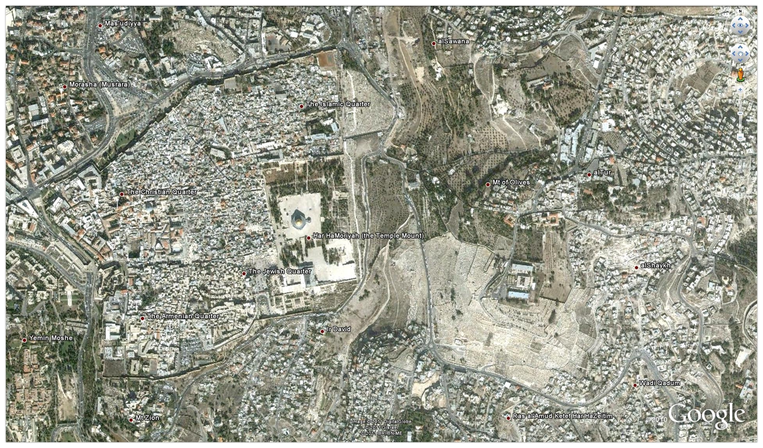

Slide 5
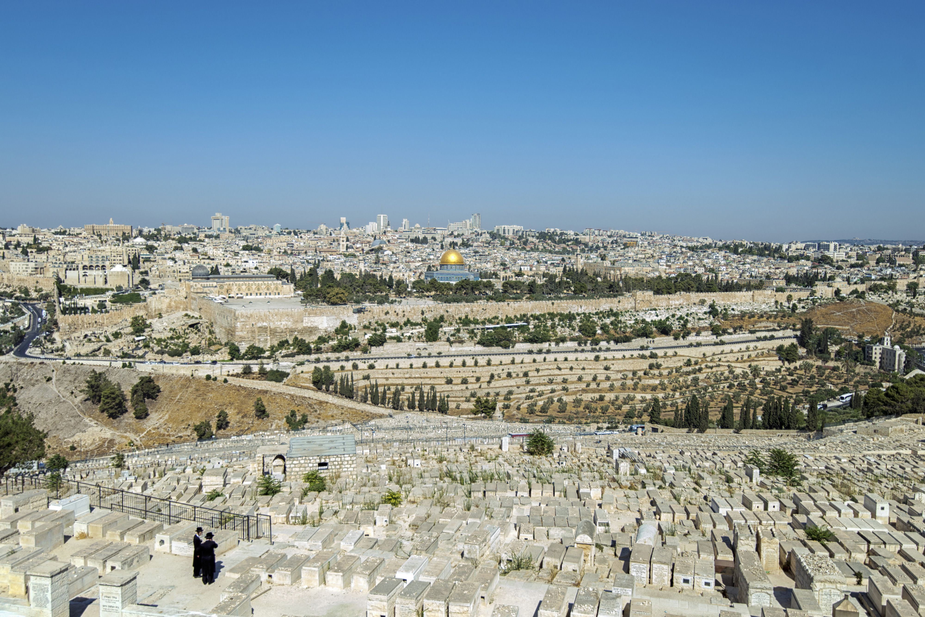

Slide 6
1 Behold, a day is coming for the Lord, when the spoil taken from you will be divided in your midst. 2 For I will gather all the nations against Jerusalem to battle, and the city shall be taken and the houses plundered and the women raped. Half of the city shall go out into exile, but the rest of the people shall not be cut off from the city.
(Zechariah 14:1-4)

Slide 7
3 Then the Lord will go out and fight against those nations as when he fights on a day of battle. 4 On that day his feet shall stand on the Mount of Olives that lies before Jerusalem on the east, and the Mount of Olives shall be split in two from east to west by a very wide valley, so that one half of the Mount shall move northward, and the other half southward.
(Zechariah 14:1-4)

Slide 8
23 we ourselves, who have the firstfruits of the Spirit, groan inwardly as we wait eagerly for adoption as sons, the redemption of our bodies. 24 For in this hope we were saved.
(Romans 8:23-24)

Slide 9
6 For I am already being poured out as a drink offering, and the time of my departure has come. 7 I have fought the good fight, I have finished the race, I have kept the faith. 8 Henceforth there is laid up for me the crown of righteousness, which the Lord, the righteous judge, will award to me on that day, and not only to me but also to all who have loved his appearing.
(2 Timothy 4:6-8)

Slide 10
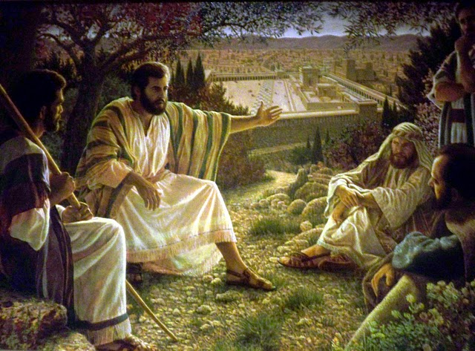

Slide 11
The Seven C’s of Consistent Interpretation
1. Context: The historical, literary, and grammatical context.
2. Common Sense: Take God’s Word at His word. Take the plainest meaning of the text unless the context deems otherwise.
3. Continuity: Interpret Scripture with Scripture.
4. Complete fulfillment: God fulfills His Word completely, not partially.
5. Correlative fulfillment: If a prophecy is partially fulfilled look for progressive fulfillment or typological fulfillment.
6. Care: Hold your interpretations with humility.
7. Confidence: Trust God to fulfill His Word in His way.

Slide 12
Kingdom Come: The Birth Pains of the Kingdom (Part I)
1. False Christs

Slide 13
False Christs: First Century/Early Church
1. an Egyptian false prophet led 30,000 men into the desert, who were almost all cut off by Felix. See Acts 21:38.
2. Soon after our Lord's crucifixion, Simon Magus appeared, and persuaded the people of Samaria that he was the great power of God, Acts 8:9, 10; and boasted among the Jews that he was the son of God.
3. Dositheus, the Samaritan, who pretended that he was the Christ foretold by Moses.
4. Theudas, who said he was a prophet, and persuaded a great multitude to follow him with their best effects to the river Jordan, which he promised to divide for their passage; and saying these things, says Josephus, he deceived many: almost the very words of our Lord.
5. A few years afterwards, under the reign of Nero, while Felix was procurator of Judea, impostors of this stamp were so frequent that some were taken and killed almost every day. Josephus. Ant. b. xx. c. 4. and 7.

Slide 14
False Christs: Historical
Ann Lee (1736–1784), a central figure to the Shakers
Bernhard Müller (c. 1799–1834) claimed to be the Lion of Judah and a prophet in possession of the Philosopher's stone.
John Nichols Thom (1799–1838), who had achieved fame and followers as Sir William Courtenay and adopted the claim of Messiah after a period in a mental institute.
Arnold Potter (1804–1872), Latter Day Saint schismatic leader; called himself "Potter Christ"
Hong Xiuquan (1814–1864), Hakka Chinese; claimed himself to be the younger brother of Jesus Christ; started the Taiping Rebellion and founded the Heavenly Kingdom of Great Peace. Committed suicide before the fall of Tianjing (Nanjing) in 1864.
Mirza Husayn 'Ali Nuri, Bahá'u'lláh (1817–1864), born Shiite, adopting Bábism later in life, he claimed to be the promised one of all religions, and founded the Bahá'í Faith.

Slide 15
False Christs: Historical
Jacobina Mentz Maurer (1841 or 1842–1874) was a German-Brazilian woman who lived and died in the state of Rio Grande do Sul who emerged as a messianic prophetess, a representation of God, and later declared the very reincarnation of Jesus Christ on earth by her German-speaking community called Die Muckers (or the false saints) by her enemies, Die Spotters (or the mockers). After a number of deadly confrontations with outsiders, Jacobina was shot to death together with many of her followers by the Brazilian Imperial Army.
William W. Davies (1833–1906), Latter Day Saint (Mormon) schismatic leader; claimed that his infant son Arthur (born 1868) was the reincarnated Jesus Christ.
Cyrus Reed Teed (October 18, 1839 – December 22, 1908, erroneously Cyrus Tweed) was a U.S. eclectic physician and alchemist turned religious leader and messiah. In 1869, claiming divine inspiration, Dr. Teed took on the name Koresh and proposed a new set of scientific and religious ideas he called Koreshanity.

Slide 16
False Christs: Modern
Abd-ru-shin (18 April 1875 – 6 December 1941), founder of the Grail Movement.[25][26][27][28]
Father Divine (George Baker) (c. 1880 – September 10, 1965), an African American spiritual leader from about 1907 until his death who claimed to be God.
André Matsoua (1899–1942), Congolese founder of Amicale, proponents of which subsequently adopted him as Messiah in the late 1920s.
Samael Aun Weor (1917–1977), born Víctor Manuel Gómez Rodríguez, Colombian citizen and later Mexican, was an author, lecturer and founder of the 'Universal Christian Gnostic Movement', according to him, 'the most powerful movement ever founded'. By 1972, he referenced that his death and resurrection would be occurring before 1978.[29]
Ahn Sahng-hong (1918–1985), founder of the World Mission Society Church of God and worshiped by the members as the messiah.[30]

Slide 17
False Christs: Modern
Sun Myung Moon (1920–2012), founder and leader of the Unification Church established in Seoul, South Korea, who considered himself the Second Coming of Christ, but not Jesus himself.[31] Although it is generally believed by Unification Church members ("Moonies") that he was the Messiah and the Second Coming of Christ and was anointed to fulfill Jesus' unfinished mission.[31]
Yahweh ben Yahweh (1935–2007), born as Hulon Mitchell, Jr., a black nationalist and separatist who created the Nation of Yahweh and allegedly orchestrated the murder of dozens of persons.
Laszlo Toth (1940–2012) claimed he was Jesus Christ as he battered Michelangelo's Pieta with a geologist hammer.
Wayne Bent (born 1941), also known as Michael Travesser of the Lord Our Righteousness Church, also known as the "Strong City Cult", convicted December 15, 2008 of one count of criminal sexual contact of a minor and two counts of contributing to the delinquency of a minor in 2008.[32]

Slide 18
False Christs: Modern
Iesu Matayoshi (born 1944), in 1997 he established the World Economic Community Party based on his conviction that he is God and the Christ.
Jung Myung Seok (born 1945), a South Korean who was a member of the Unification Church in the 1970s, before breaking off to found the dissenting group[33] now known as Providence Church in 1980.[34][35] He also considers himself the Second Coming of Christ, but not Jesus himself in 1980.[36] He believes he has come to finish the incomplete message and mission of Jesus Christ, asserting that he is the Messiah and has the responsibility to save all mankind.[37] He claims that the Christian doctrine of resurrection is false but that people can be saved through him.[38]
Claude Vorilhon now known as Raël "messenger of the Elohim" (born 1946), a French professional test driver and former car journalist became founder and leader of UFO religion the Raël Movement in 1972, which teaches that life on Earth was scientifically created by a species of extraterrestrials, which they call Elohim. He claimed he met an extraterrestrial humanoid in 1973 and became the Messiah.[39] Then devoted himself to the task he said was given by his "biological father", an extraterrestrial named Yahweh.[40]

Slide 19
False Christs: Modern
José Luis de Jesús (1946–2013), founder and leader of Creciendo en Gracia sect (Growing In Grace International Ministry, Inc.), based in Miami, Florida. He claimed to be both Jesus Christ returned and the Antichrist, and exhibited a "666" tattoo on his forearm. He has referred to himself as Jesucristo Hombre, which translates to "Jesus Christ made Man".
Inri Cristo (born 1948) of Indaial, Brazil, a claimant to be the second Jesus.[41]
Apollo Quiboloy (born 1950), founder and leader of the Kingdom of Jesus Christ religious group, who claims that Jesus Christ is the "Almighty Father," that Quiboloy is "His Appointed Son," and that salvation is now completed. Proclaims himself as the "Appointed Son of the God" not direct to the point as the "Begotten Son of the God" in 1985.[42]
David Icke (born 1952), of Great Britain, has described himself as "the son of God", and a "channel for the Christ spirit".

Slide 20
False Christs: Modern
Brian David Mitchell was born on October 18, 1953 in Salt Lake City, Utah, he believed himself the fore-ordained angel born on earth to be the Davidic "servant" prepared by God as a type of Messiah who would restore the divinely led kingdom of Israel to the world in preparation for Christ's second coming. (Mitchell's belief in such an end-times figure – also known among many fundamentalist Latter Day Saints as "the One Mighty and Strong" – appeared to be based in part on a reading of the biblical book of Isaiah by the independent LDS Hebraist, Avraham Gileadi, with which Mitchell became familiar from his former participation with Stirling Allan's American Study Group.)[43][44]
David Koresh (Vernon Wayne Howell) (1959–1993), leader of the Branch Davidians.
Maria Devi Christos (born 1960), founder of the Great White Brotherhood.
Sergey Torop (born 1961), who started to call himself "Vissarion", founder of the Church of the Last Testament and the spiritual community Ecopolis Tiberkul in Southern Siberia.

Slide 21
False Christs: Modern
Alan John Miller (born 1962), founder of Divine Truth, a new religious movement based in Australia. Alan John Miller, also known as A.J., who claims to be Jesus of Nazareth through reincarnation. Miller was formerly an elder in the Jehovah's Witnesses.
David Shayler (born 1965), former MI5 agent and whistleblower who declared himself the Messiah on 7 July 2007.[45]

Slide 22
False Christs: Political
False Christs: Own Making (the need for a Messiah)
False Christs: The Antichrist
The rider on the white horse in Revelation 6:1-2 is the Antichrist, that final world dictator who will lead the nations astray. He will begin his career as a peacemaker, signing a covenant with Israel to protect her from her enemies (Dan. 9:27). Israel will welcome this man as their great benefactor (John 5:43).

Slide 23
Kingdom Come: The Birth Pains of the Kingdom (Part I)
1. False Christs
2. Conflicts (National, Regional, Ethnic)

Slide 24
Conflicts (National, Regional, Ethnic)
* Sectarian Conflicts on the rise
* Divisions in our own country

Slide 25
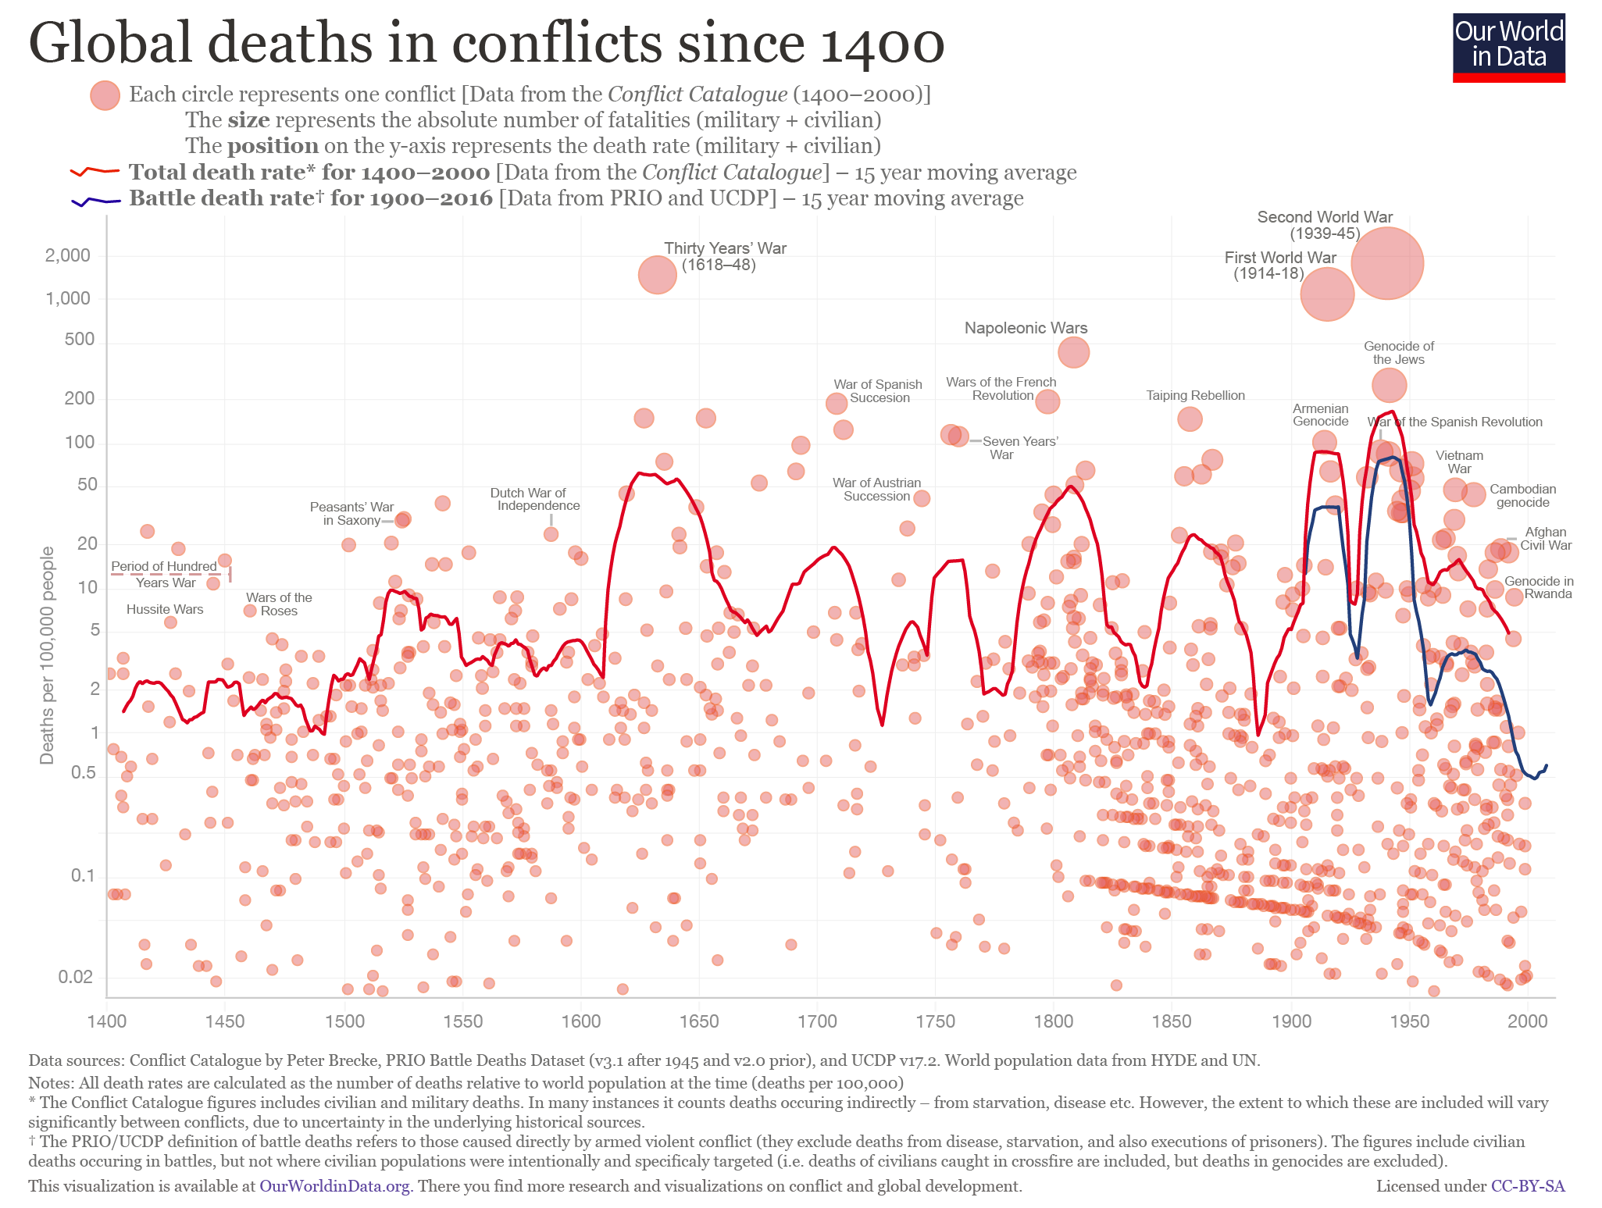

Slide 26
Kingdom Come: The Birth Pains of the Kingdom (Part I)
1. False Christs
2. Conflicts (National, Regional, Ethnic)
3. Famines

Slide 27
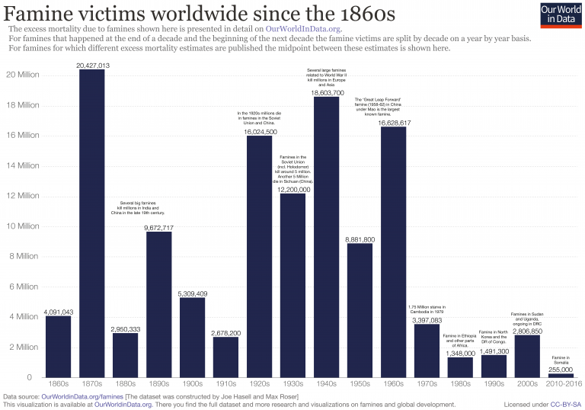

Slide 29
7 When he opened the fourth seal, I heard the voice of the fourth living creature say, “Come!” 8 And I looked, and behold, a pale horse! And its rider's name was Death, and Hades followed him. And they were given authority over a fourth of the earth, to kill with sword and with famine and with pestilence and by wild beasts of the earth. (Revelation 6:7-8)

Slide 30
Kingdom Come: The Birth Pains of the Kingdom (Part I)
1. False Christs
2. Conflicts (National, Regional, Ethnic)
3. Famines
4. Pestilences

Slide 31
10 Then he said to them, “Nation will rise against nation, and kingdom against kingdom. 11 There will be great earthquakes, and in various places famines and pestilences.
(Luke 21:10-11)

Slide 32
Pestilences
Pandemics are making a comeback.
(SARS, Mad Cow Disease, Ebola outbreaks)
Antibiotic resistant diseases

Slide 33
Kingdom Come: The Birth Pains of the Kingdom (Part I)
1. False Christs
2. Conflicts (National, Regional, Ethnic)
3. Famines
4. Pestilences
5. Earthquakes (Natural Disasters)

Slide 34
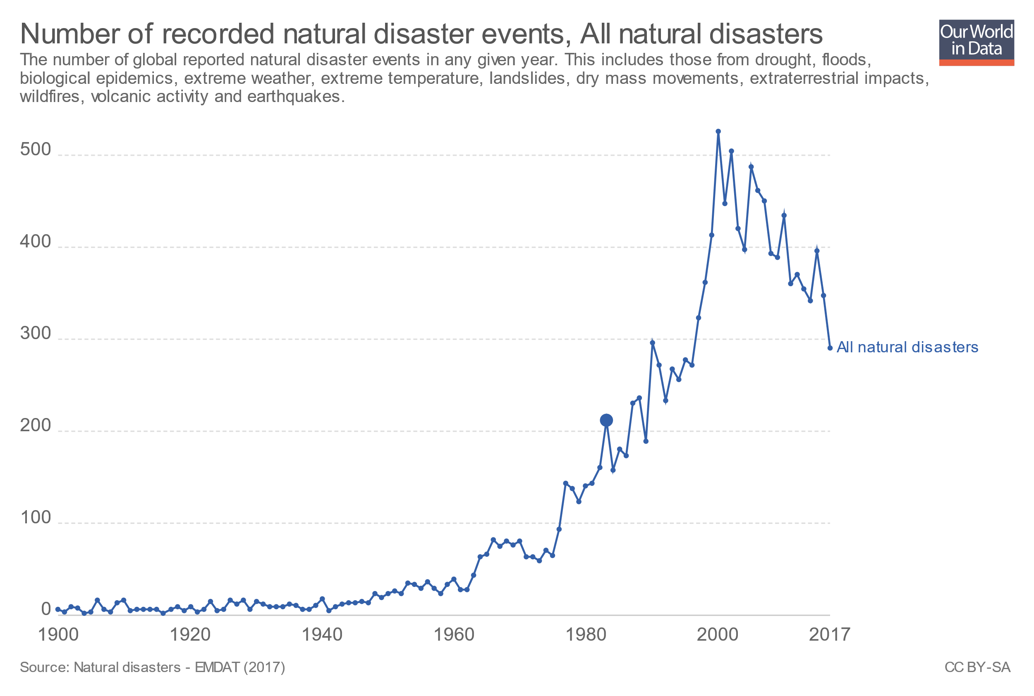

Slide 35
12 When he opened the sixth seal, I looked, and behold, there was a great earthquake, and the sun became black as sackcloth, the full moon became like blood, 13 and the stars of the sky fell to the earth as the fig tree sheds its winter fruit when shaken by a gale. 14 The sky vanished like a scroll that is being rolled up, and every mountain and island was removed from its place.
(Revelation 6:12-17)

Slide 36
15 Then the kings of the earth and the great ones and the generals and the rich and the powerful, and everyone, slave[d] and free, hid themselves in the caves and among the rocks of the mountains, 16 calling to the mountains and rocks, “Fall on us and hide us from the face of him who is seated on the throne, and from the wrath of the Lamb, 17 for the great day of their wrath has come, and who can stand?” (Revelation 6:12-17)

Slide 37
Kingdom Come: The Birth Pains of the Kingdom (Part I)
1. False Christs
2. Conflicts (National, Regional, Ethnic)
3. Famines
4. Pestilences
5. Earthquakes (Natural Disasters)

Slide 38
My Response
1. Put your confidence in God’s Word

Slide 39
18 For truly, I say to you, until heaven and earth pass away, not an iota, not a dot, will pass from the Law until all is accomplished.
(Matthew 5:18)

Slide 40
My Response
1. Place your confidence in God’s Word
2. Prepare for the birth pains
* Expect persecution, not comfort
* Avoid deception through God’s Word

Slide 41
12 Indeed, all who desire to live a godly life in Christ Jesus will be persecuted, 13 while evil people and impostors will go on from bad to worse, deceiving and being deceived. 14 But as for you, continue in what you have learned and have firmly believed, knowing from whom you learned it
(2 Timothy 3:12-16)

Slide 42
15 and how from childhood you have been acquainted with the sacred writings, which are able to make you wise for salvation through faith in Christ Jesus. 16 All Scripture is breathed out by God and profitable for teaching, for reproof, for correction, and for training in righteousness, 17 that the man of God may be complete, equipped for every good work.
(2 Timothy 3:12-16)

Slide 43
11 And he gave the apostles, the prophets, the evangelists, the shepherds and teachers, 12 to equip the saints for the work of ministry, for building up the body of Christ, 13 until we all attain to the unity of the faith and of the knowledge of the Son of God, to mature manhood, to the measure of the stature of the fullness of Christ, 14 so that we may no longer be children, tossed to and fro by the waves and carried about by every wind of doctrine, by human cunning, by craftiness in deceitful schemes.
(Ephesians 4:11-16)

Slide 44
15 Rather, speaking the truth in love, we are to grow up in every way into him who is the head, into Christ, 16 from whom the whole body, joined and held together by every joint with which it is equipped, when each part is working properly, makes the body grow so that it builds itself up in love.
(Ephesians 4:11-16)

Slide 45
My Response
1. Place your confidence in God’s Word
2. Prepare for the birth pains
* Expect persecution, not comfort
* Avoid deception through God’s Word
3. Persevere in the promise of Christ’s return

Slide 46
18 For I consider that the sufferings of this present time are not worth comparing with the glory that is to be revealed to us. 19 For the creation waits with eager longing for the revealing of the sons of God. 20 For the creation was subjected to futility, not willingly, but because of him who subjected it, in hope 21 that the creation itself will be set free from its bondage to corruption and obtain the freedom of the glory of the children of God.
(Romans 8:18-25)

Slide 47
22 For we know that the whole creation has been groaning together in the pains of childbirth until now. 23 And not only the creation, but we ourselves, who have the firstfruits of the Spirit, groan inwardly as we wait eagerly for adoption as sons, the redemption of our bodies. 24 For in this hope we were saved. Now hope that is seen is not hope. For who hopes for what he sees? 25 But if we hope for what we do not see, we wait for it with patience.
(Romans 8:18-25)

Slide 48
My Response
1. Place your confidence in God’s Word
2. Prepare for the birth pains
* Expect persecution, not comfort
* Avoid deception through God’s Word
3. Persevere in the promise of Christ’s return

